Slide 1
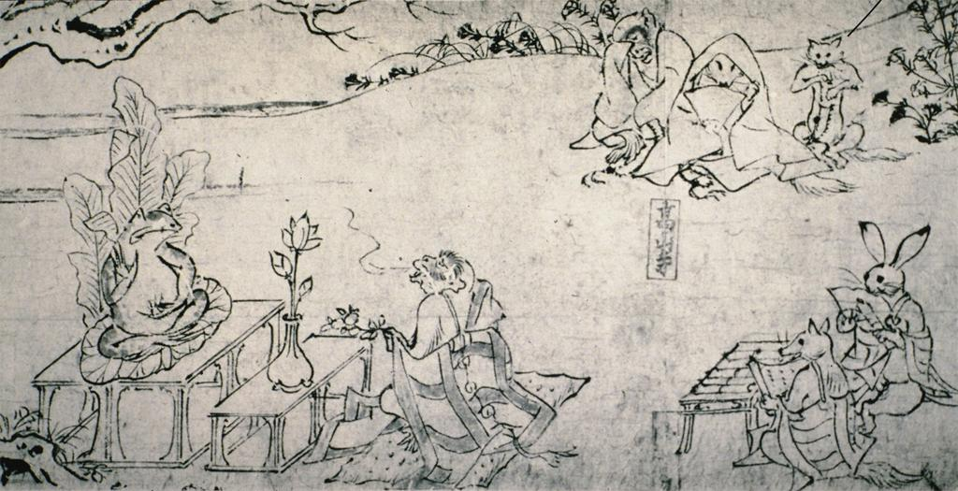
ARTH 3740 FAR EASTERN PAINTING
Fall 2016, MW 12:20-1:35 PM
With Prof. Yan Geng
A great journey to Far Eastern Asia, exploring the major trends in painting in China from the Han Dynasty (206 B.C. – 220 A.D. ) to the present, and in Japan from the Nara Period (710 – 784 A.D.) to the present.

Slide 2
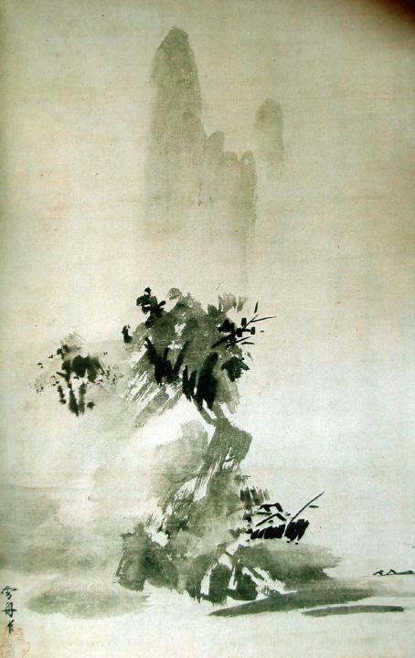
ARTH 3740
FAR EASTERN PAINTING
Fall 2016
MW 12:20-1:35 PM
A great journey to Far Eastern Asia, exploring the major trends in painting in China from the Han Dynasty (206 B.C. – 220 A.D. ) to the present, and in Japan from the Nara Period (710 – 784 A.D.) to the present.
With Prof. Yan Geng

Slide 3
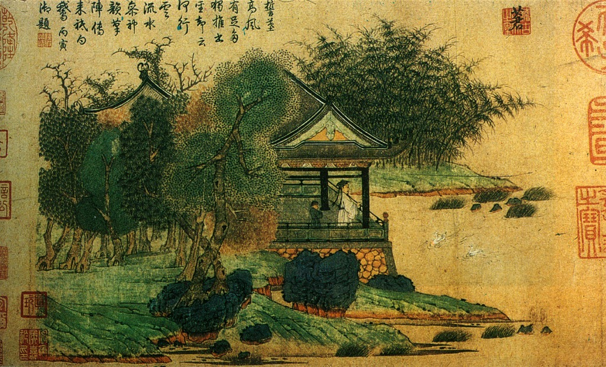
ARTH 3740 FAR EASTERN PAINTING
Fall 2016, MW 12:20-1:35 PM
With Prof. Yan Geng
A great journey to Far Eastern Asia, exploring the major trends in painting in China from the Han Dynasty (206 B.C. – 220 A.D. ) to the present, and in Japan from the Nara Period (710 – 784 A.D.) to the present.

Slide 4
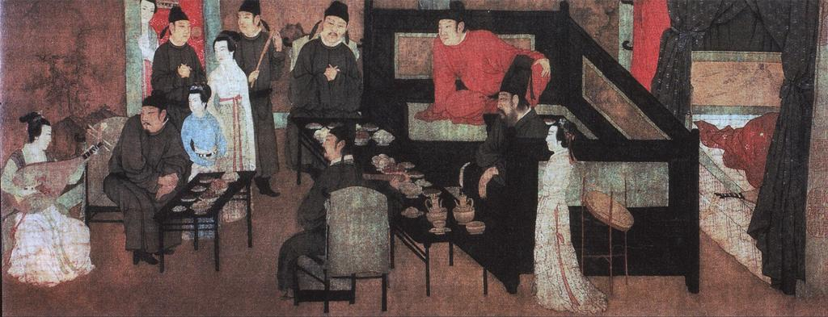
ARTH 3740 FAR EASTERN PAINTING
Fall 2016, MW 12:20-1:35 PM
With Prof. Yan Geng
A great journey to Far Eastern Asia, exploring the major trends in painting in China from the Han Dynasty (206 B.C. – 220 A.D. ) to the present, and in Japan from the Nara Period (710 – 784 A.D.) to the present.

